Slide 1


Presented by
Notes:
Pledge and BBOT logos. Maybe we can make this whole slide a picture? Maybe the grassy walkway one?

Slide 2






Pledge
for a Sustainable Community
2015 World Chambers Competition
Best Corporate Social Responsibility Project
Burnaby Board of Trade
Notes:
Pledge and BBOT logos. Maybe we can make this whole slide a picture? Maybe the grassy walkway one?

Slide 3
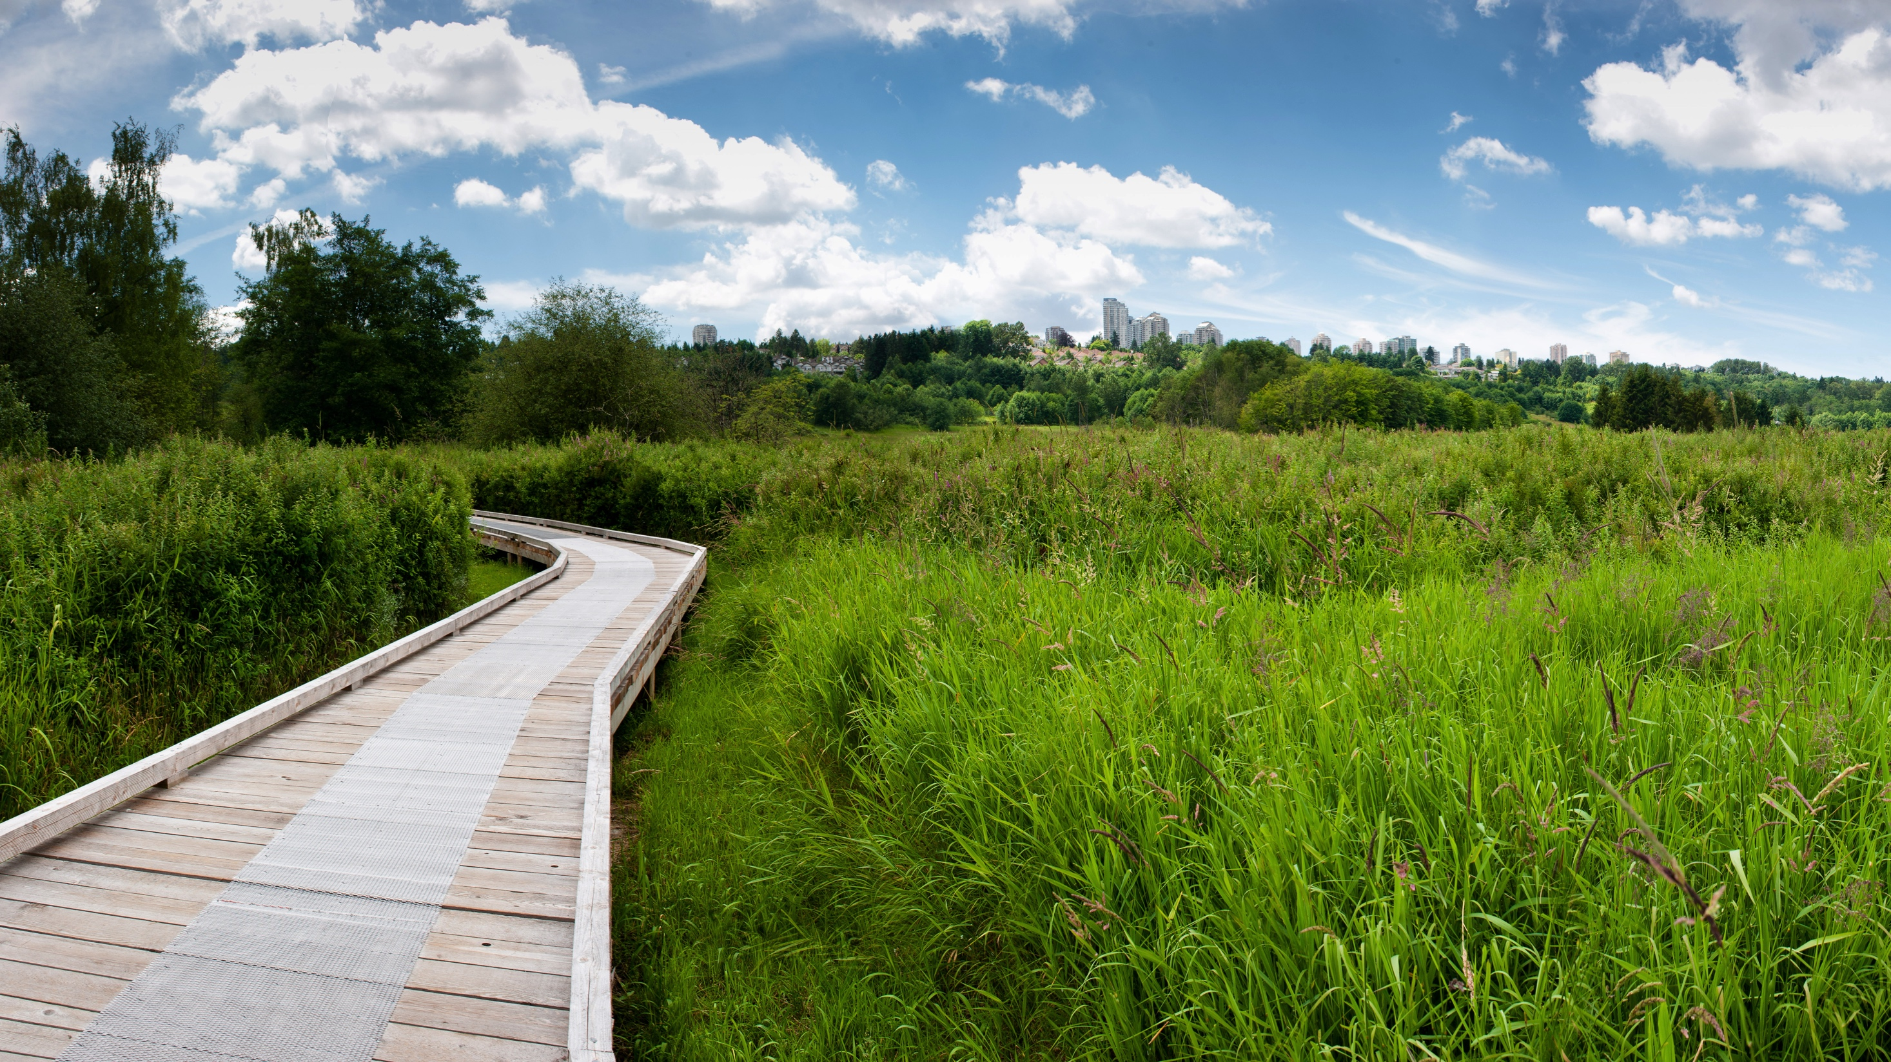
Notes:
Pledge and BBOT logos. Maybe we can make this whole slide a picture? Maybe the grassy walkway one?

Slide 4
simply defined
Notes:
Pledge and BBOT logos. Maybe we can make this whole slide a picture? Maybe the grassy walkway one?

Slide 5









First launched in 2012, the Burnaby Board of Trade’s
Pledge for a Sustainable Community program—bbotpledge.ca
—is a comprehensive online resource and programming platform
with the goal of helping businesses large and small reduce their environmental footprint and promote their company at the same time.
Notes:
A lot of words on this slide, but can be broken up depending on design. Maybe just use site graphic here (e.g. overview “people” pic or drops as above)

Slide 6




Participants can:
Access valuable resources
Access tips and case studies
Share their successes and serve as role models
Pledge to take on new challenges
Notes:
A lot of words on this slide, but can be broken up depending on design. Maybe just use site graphic here (e.g. overview “people” pic or drops as above)

Slide 7
Participants receive recognition:
On Burnaby Board of Trade communication channels
At BBOT events
In the membership directory
Often even in the local media
Notes:
A lot of words on this slide, but can be broken up depending on design. Maybe just use site graphic here (e.g. overview “people” pic or drops as above)

Slide 8

broadly defined
Notes:
Pledge and BBOT logos. Maybe we can make this whole slide a picture? Maybe the grassy walkway one?

Slide 9

The Pledge is more than an environmental resource, it is a commitment that businesses voluntarily make to serve as role models, better their community, and improve their operational standards.
It is a tool through which the Burnaby Board of Trade has begun to build a genuine community of sustainable practice and programming.

Slide 10





user friendly
We make it simple. The site features easy to use guidelines for navigation, and to effectively communicate the purpose and value of the program.
Notes:
Probably just any relevant-looking website icons here.

Slide 11
categories
The online resource at bbotpledge.ca consists of a number of features, centered on five eco-action categories:
Notes:
Pretty self explanatory?

Slide 12
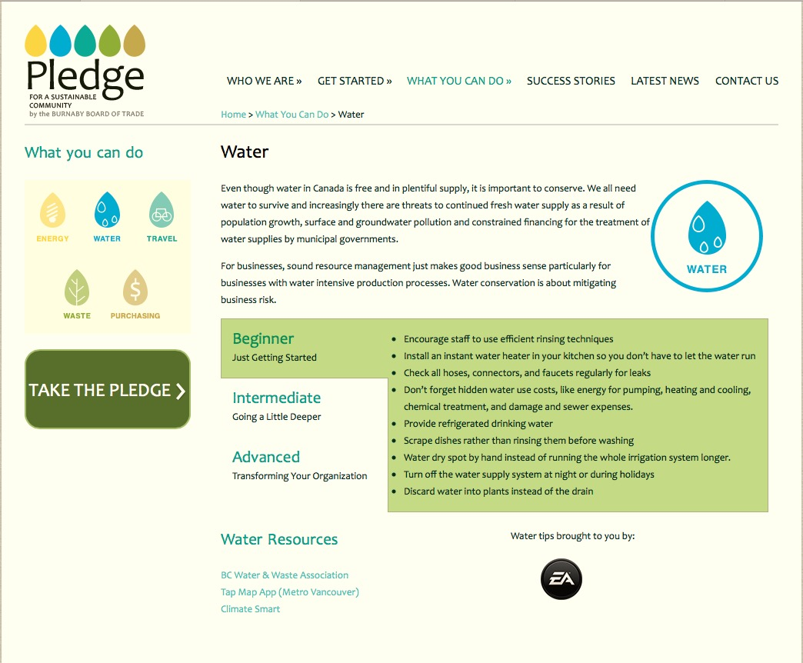
levels
Resources and tips to reduce environmental impact are broken down into different levels: Beginner, Intermediate, and Advanced.
This makes taking the Pledge accessible and unintimidating, yet still offers the option of significant (transformative) actions for a higher level of commitment.
Notes:
I don’t know how to pull this off, But I want to show what the “beginner, intermediate, advanced” looks like.

Slide 13
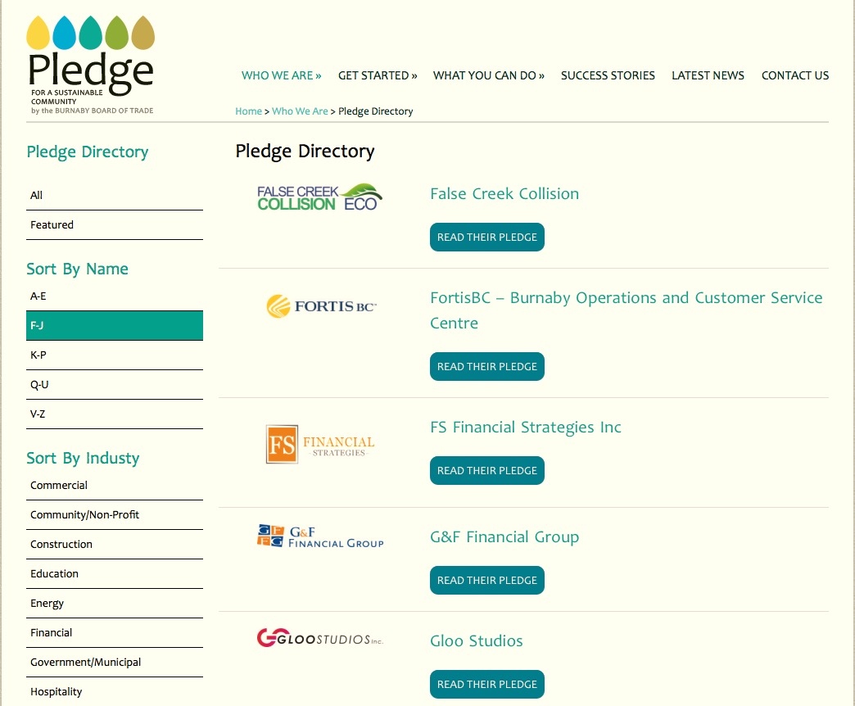
directory
Submitted profiles are featured with the business’s logo in the Pledge Directory which is searchable alphabetically and by industry category.
Users can login to review and update their Pledge commitments.
Notes:
Like the last one …

Slide 14

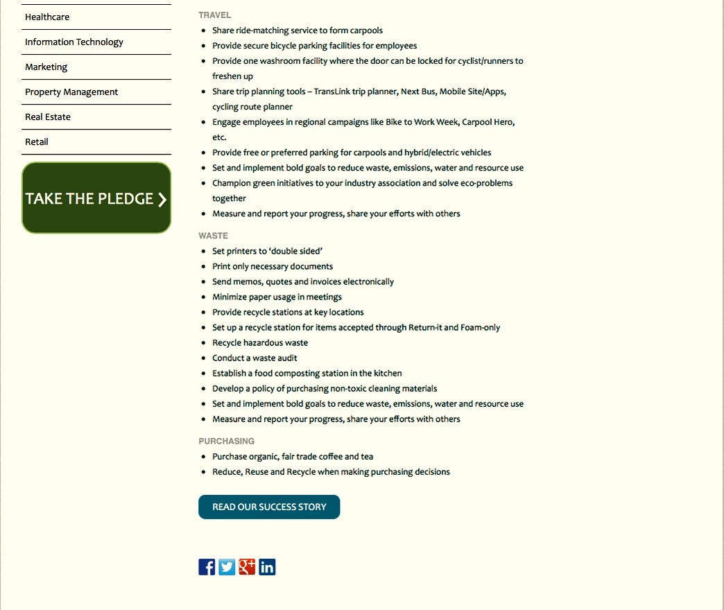
a pledge
Notes:
Like the last one …

Slide 15
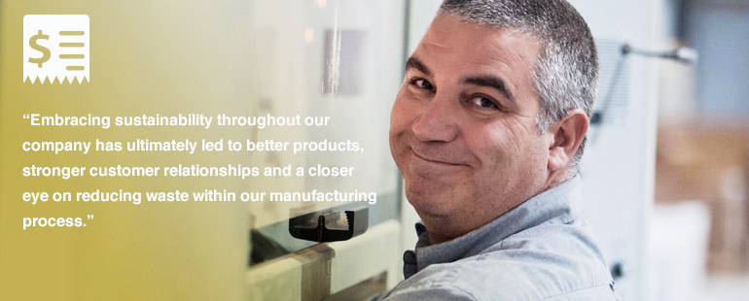
success stories
Other elements of the site include the Success Story section where we feature inspirational case studies and interviews, and the News section where we can post a variety of interesting and informative content.
Hemlock Printers
Burnaby, BC

Slide 16

sponsorship
The site includes significant sponsor recognition space, which provides chambers an opportunity to strengthen partnerships with financial supporters in their community, and can offset licensing costs or generate new revenue.
PLEDGE PROGRAM PLATINUM SPONSORS
PLEDGE PROGRAM GOLD SPONSORS

Slide 17
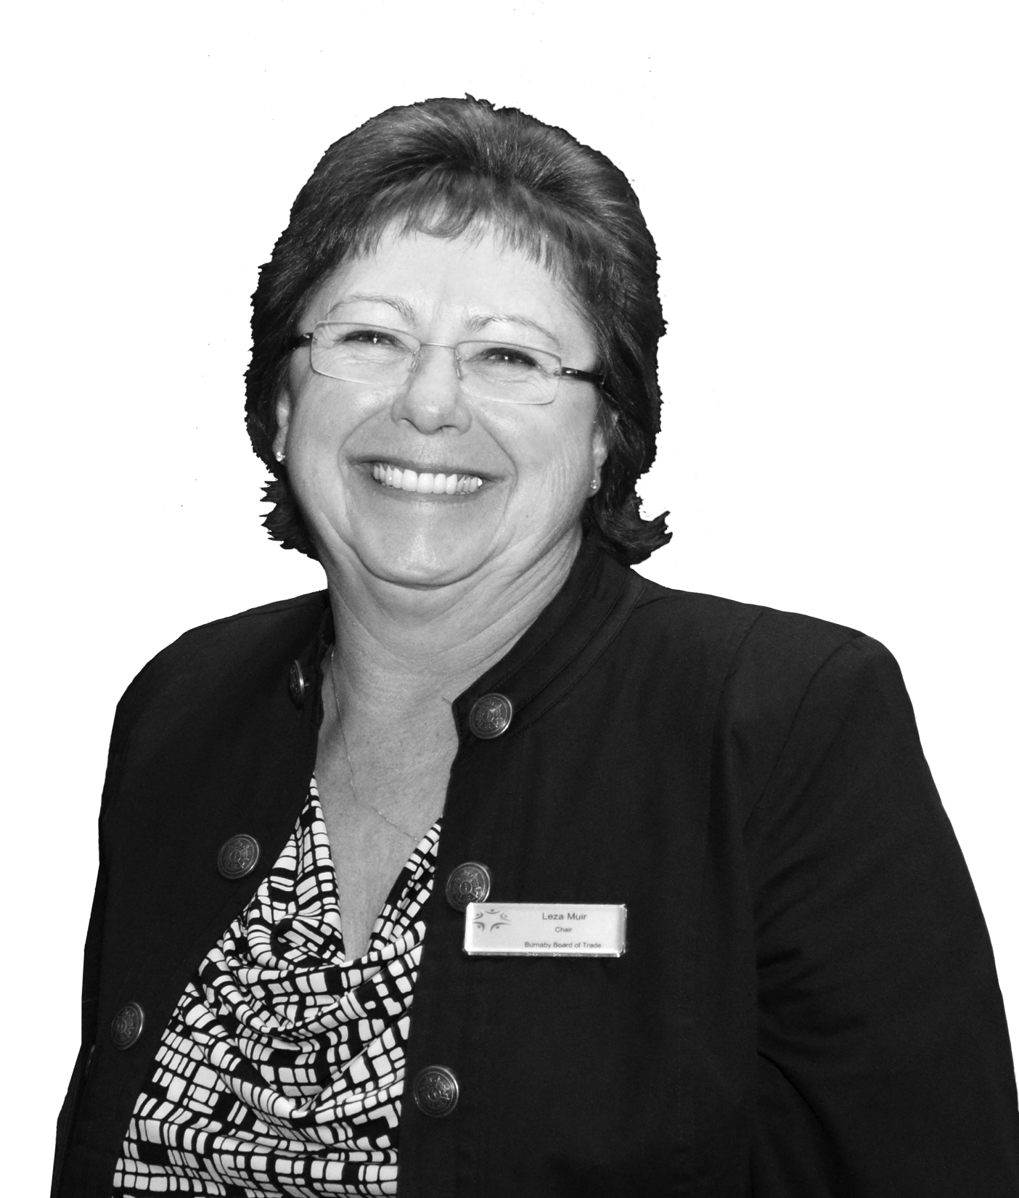
“Having the Pledge as a resource and promotional opportunity for our business community has had a profound impact on the Burnaby Board of Trade.
It’s a truly unique member benefit, a wonderful community outreach tool, and an outstanding environmental initiative. It sets our board of trade apart from every other board or chamber in the country.”
Leza Muir
Sr. Vice-President, Claims Services, Pacific Blue Cross
Chair, Burnaby Board of Trade

Slide 18

results and influence
Notes:
Pledge and BBOT logos. Maybe we can make this whole slide a picture? Maybe the grassy walkway one?

Slide 19





Notes:
Info graphic for first 5 bullets? Not sure about last 2 …

Slide 20
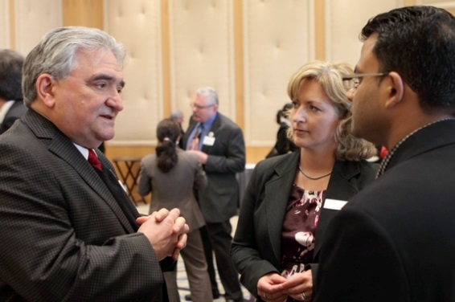
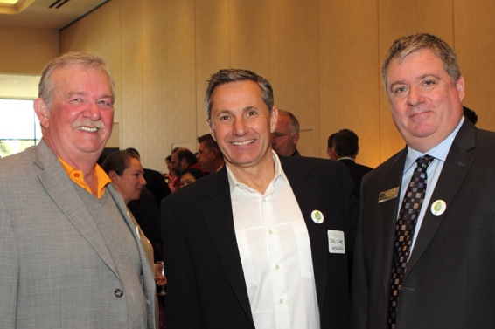
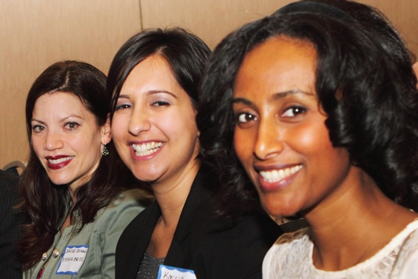
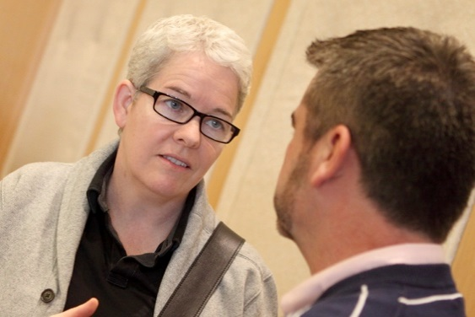
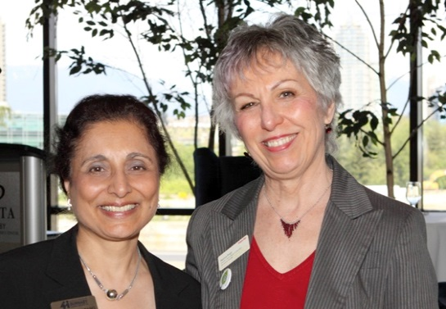
The program has also had a great impact on the Burnaby Board of Trade itself, through member engagement and a stronger relationship with several of our community partners.
It has provided greater exposure for the Board of Trade, and solidified our position in the community as a leader in sustainability.
Notes:
Info graphic for first 5 bullets? Not sure about last 2 …

Slide 21
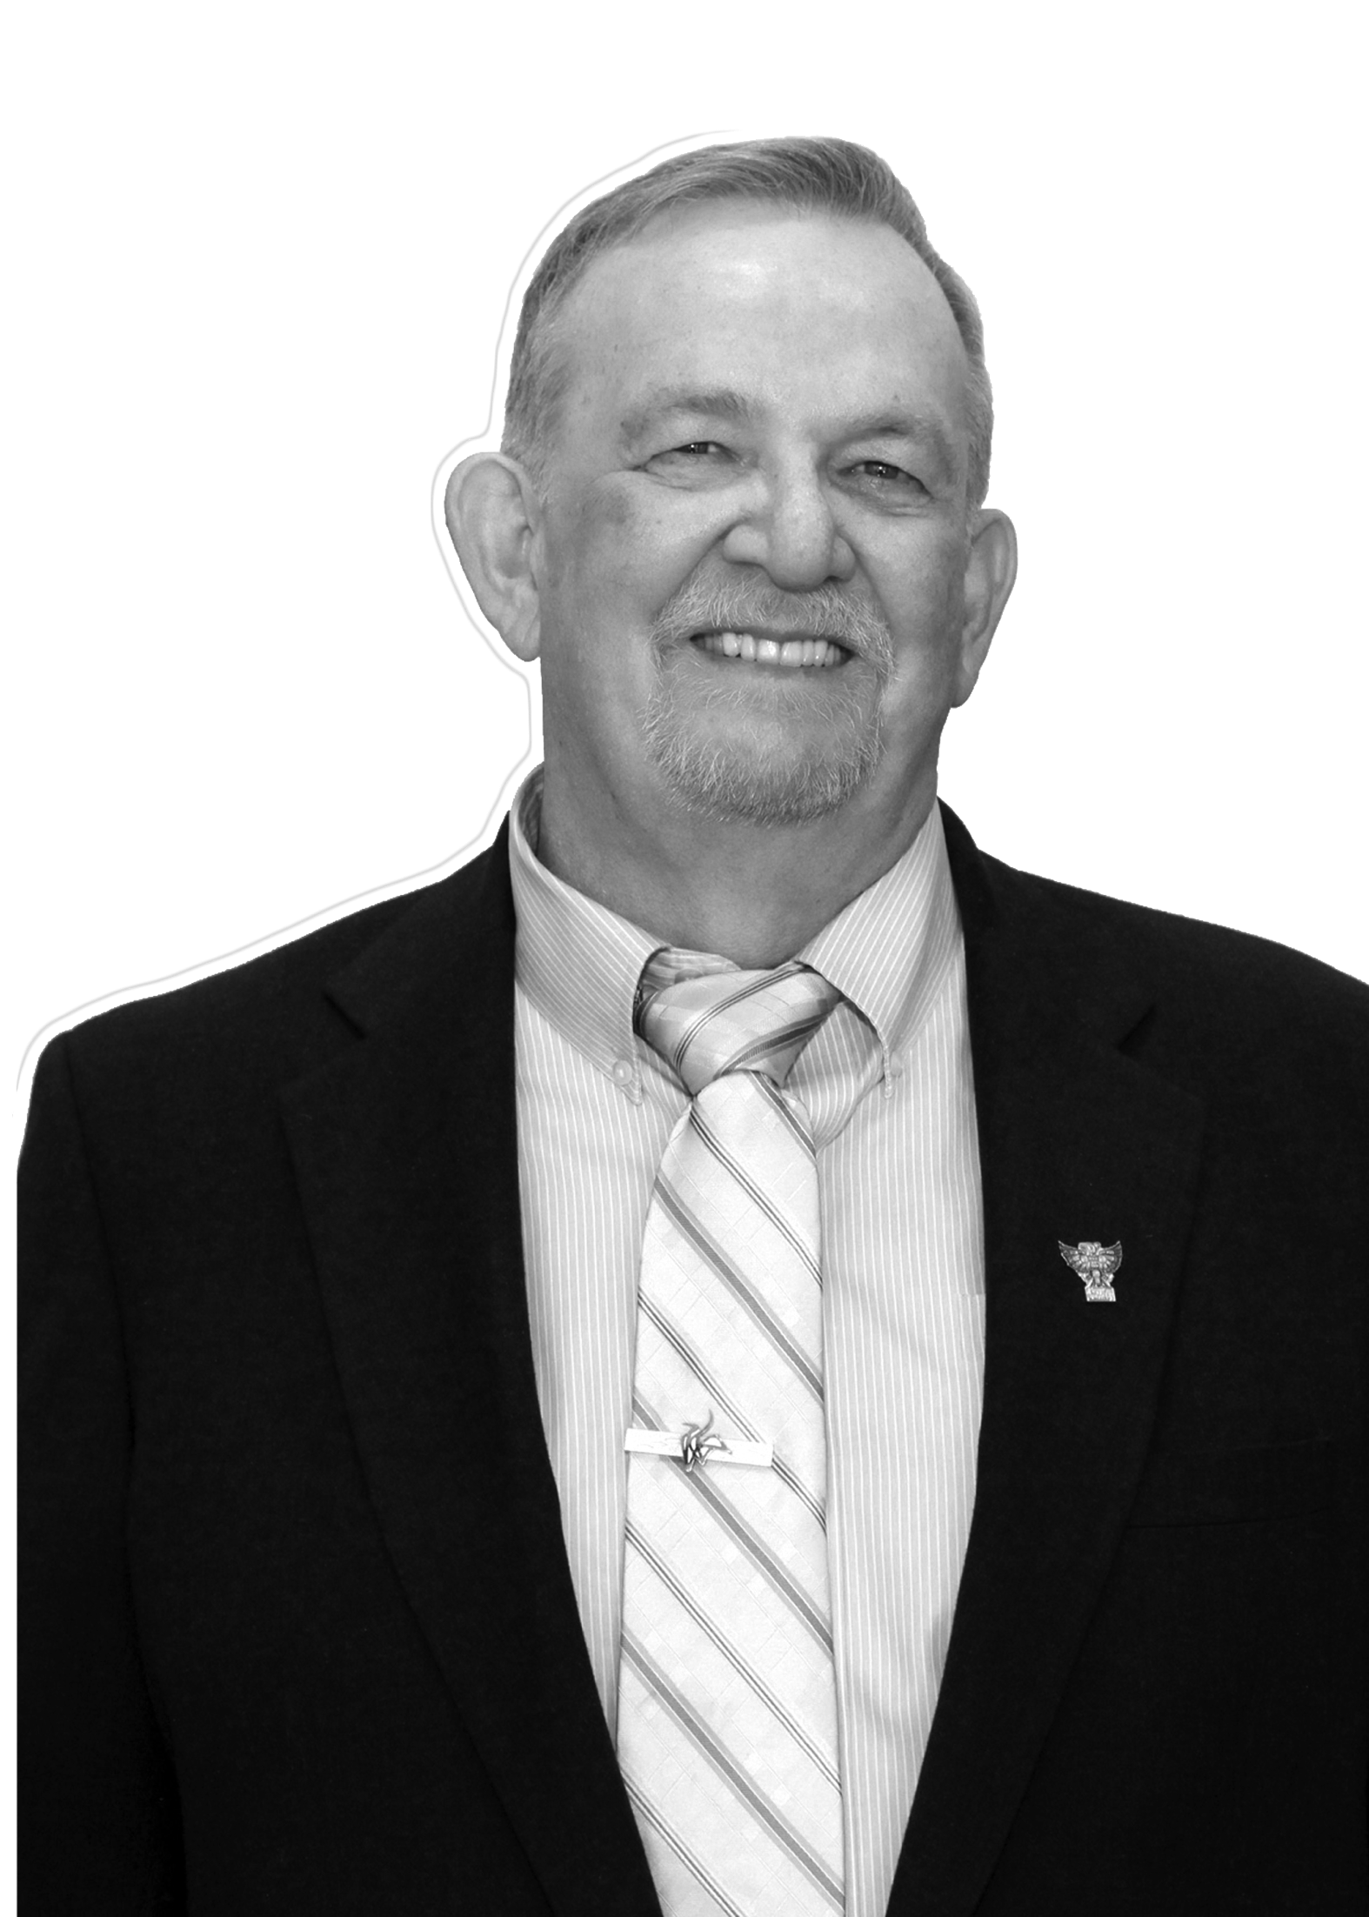
“Pledge Members serve as role models in the community and help solidify Burnaby’s reputation as a great place to come and do business.
As the Pledge program continues to grow, it is
my hope and expectation that other communities will be able to enjoy the same benefits that have made the program such a success here.”
Burnaby Mayor Derek Corrigan
Notes:
Full image background for all the testimonial slides (4 in total)

Slide 22
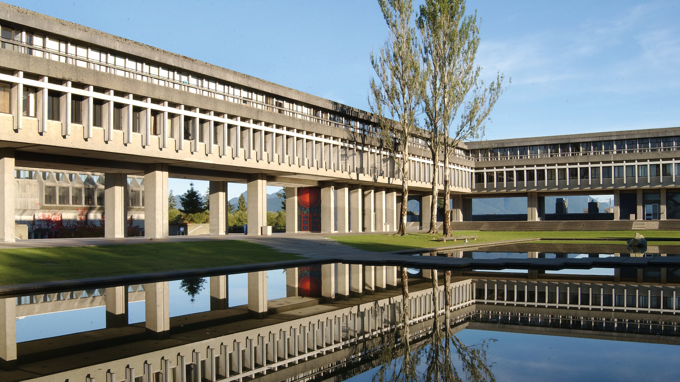
transferability, licensing
& expansion
Notes:
Pledge and BBOT logos. Maybe we can make this whole slide a picture? Maybe the grassy walkway one?

Slide 23
The Pledge for a Sustainable Community is applicable to any chamber or board that believes business has a role to play in the environmental sustainability of their community – which should be all.
Built to
Transcend
Licensable
&
Affordable
Reward
with less
Effort
Early
Adopters
Notes:
I’m thinking boxes. Four boxes for the bullet points? Maybe a header box for the top line?

Slide 24
“Tempe Chamber is excited about working with [the BBOT] to bring the Pledge for a Sustainable Community to our area. The program fits right in to our
City’s and University’s goals of creating a sustainable community. I believe the program will not only be attractive to our businesses, but will enhance the reputation of our chamber as a progressive, community-oriented organization.”
Mary Ann Miller – President & CEO, Tempe Chamber of Commerce
“I believe the Pledge you have developed is one of the best new
tools for business and community engagement that I have come
across in the last 10 years and we at the Richmond Chamber
look forward to launching our own Pledge to the business
community of Richmond next year with your support.”
Craig Jones – (Former) Executive Director, Richmond Chamber of Commerce

Slide 25
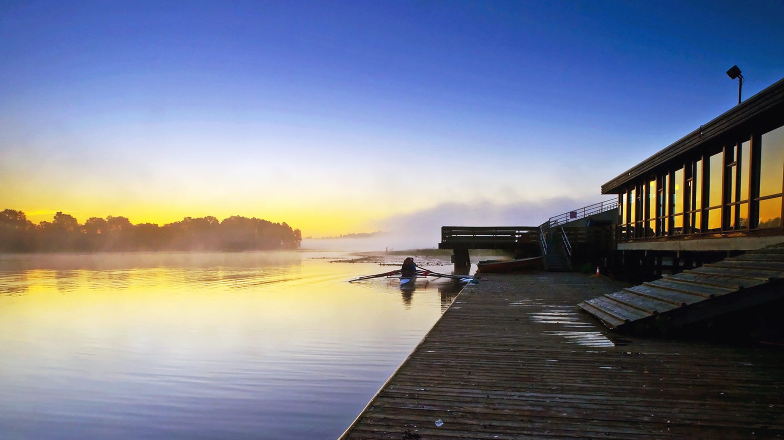
the Pledge is unique
Notes:
Pledge and BBOT logos. Maybe we can make this whole slide a picture? Maybe the grassy walkway one?

Slide 26
Although there are many chambers and boards around the world that have instituted various sustainability initiatives in their communities, we believe that there has never been a program as complete and comprehensive as the Pledge for a Sustainable Community.
It is an informational resource
It is a business and chamber promotional tool
It is a community-building mechanism

Slide 27
Although there are many chambers and boards around the world that have instituted various sustainability initiatives in their communities, we believe that there has never been a program as complete and comprehensive as the Pledge for a Sustainable Community.
It is an informational resource
It is a business and chamber promotional tool
It is a community-building mechanism

Slide 28
Although there are many chambers and boards around the world that have instituted various sustainability initiatives in their communities, we believe that there has never been a program as complete and comprehensive as the Pledge for a Sustainable Community.
It is an informational resource
It is a business and chamber promotional tool
It is a community-building mechanism

Slide 29
It attracts new corporate interest in the chamber community
It allows alignment in CSR goals across numerous organizations
It creates an opportunity for chambers and boards to develop new revenue streams through sponsorship and partnerships
It is an umbrella under which a chamber can create an entire sustainability platform

Slide 30
It attracts new corporate interest in the chamber community
It allows alignment in CSR goals across numerous organizations
It creates an opportunity for chambers and boards to develop new revenue streams through sponsorship and partnerships
It is an umbrella under which a chamber can create an entire sustainability platform

Slide 31
It attracts new corporate interest in the chamber community
It allows alignment in CSR goals across numerous organizations
It creates an opportunity for chambers and boards to develop new revenue streams through sponsorship and partnerships
It is an umbrella under which a chamber can create an entire sustainability platform

Slide 32
It attracts new corporate interest in the chamber community
It allows alignment in CSR goals across numerous organizations
It creates an opportunity for chambers and boards to develop new revenue streams through sponsorship and partnerships
It is an umbrella under which a chamber can create an entire sustainability platform

Slide 33
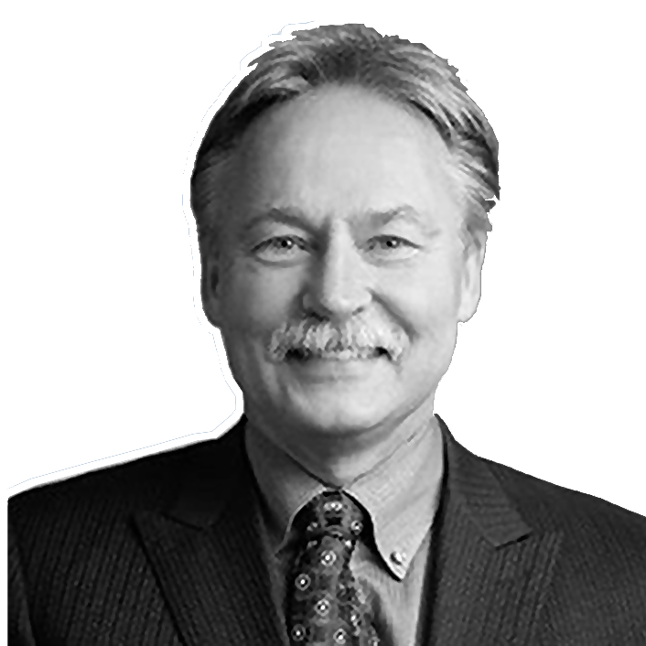
“The Pledge program is an exemplary example of a tool that both encourages best practices within businesses, and also provides a platform for awareness and promotion of positive business activities.
The Pledge will soon be available for licensing by chambers and boards of trade across the country and internationally. I believe this will be a great benefit to many of our member organizations. I will be lending my personal support to this initiative.”
Michael McMullen
Chair, Canadian Chamber of Commerce

Slide 34

building a better
business community
Notes:
Pledge and BBOT logos. Maybe we can make this whole slide a picture? Maybe the grassy walkway one?

Slide 35
In a world increasingly concerned with responsible and sustainable business practices, we have provided our community with a competitive advantage – the opportunity to improve their business through simple commitments, and a chance to promote those achievements and successes.
Now we are offering that opportunity to any chamber that wants to make a positive difference and build a better, stronger local business community.

Slide 36
In a world increasingly concerned with responsible and sustainable business practices, we have provided our community with a competitive advantage – the opportunity to improve their business through simple commitments, and a chance to promote those achievements and successes.
Now we are offering that opportunity to any chamber that wants to make a positive difference and build a better, stronger local business community.

Slide 37
TOGETHER WE CAN MAKE A DIFFERENCE.

Slide 38
TOGETHER WE CAN MAKE A DIFFERENCE.
TAKE THE PLEDGE

Slide 39
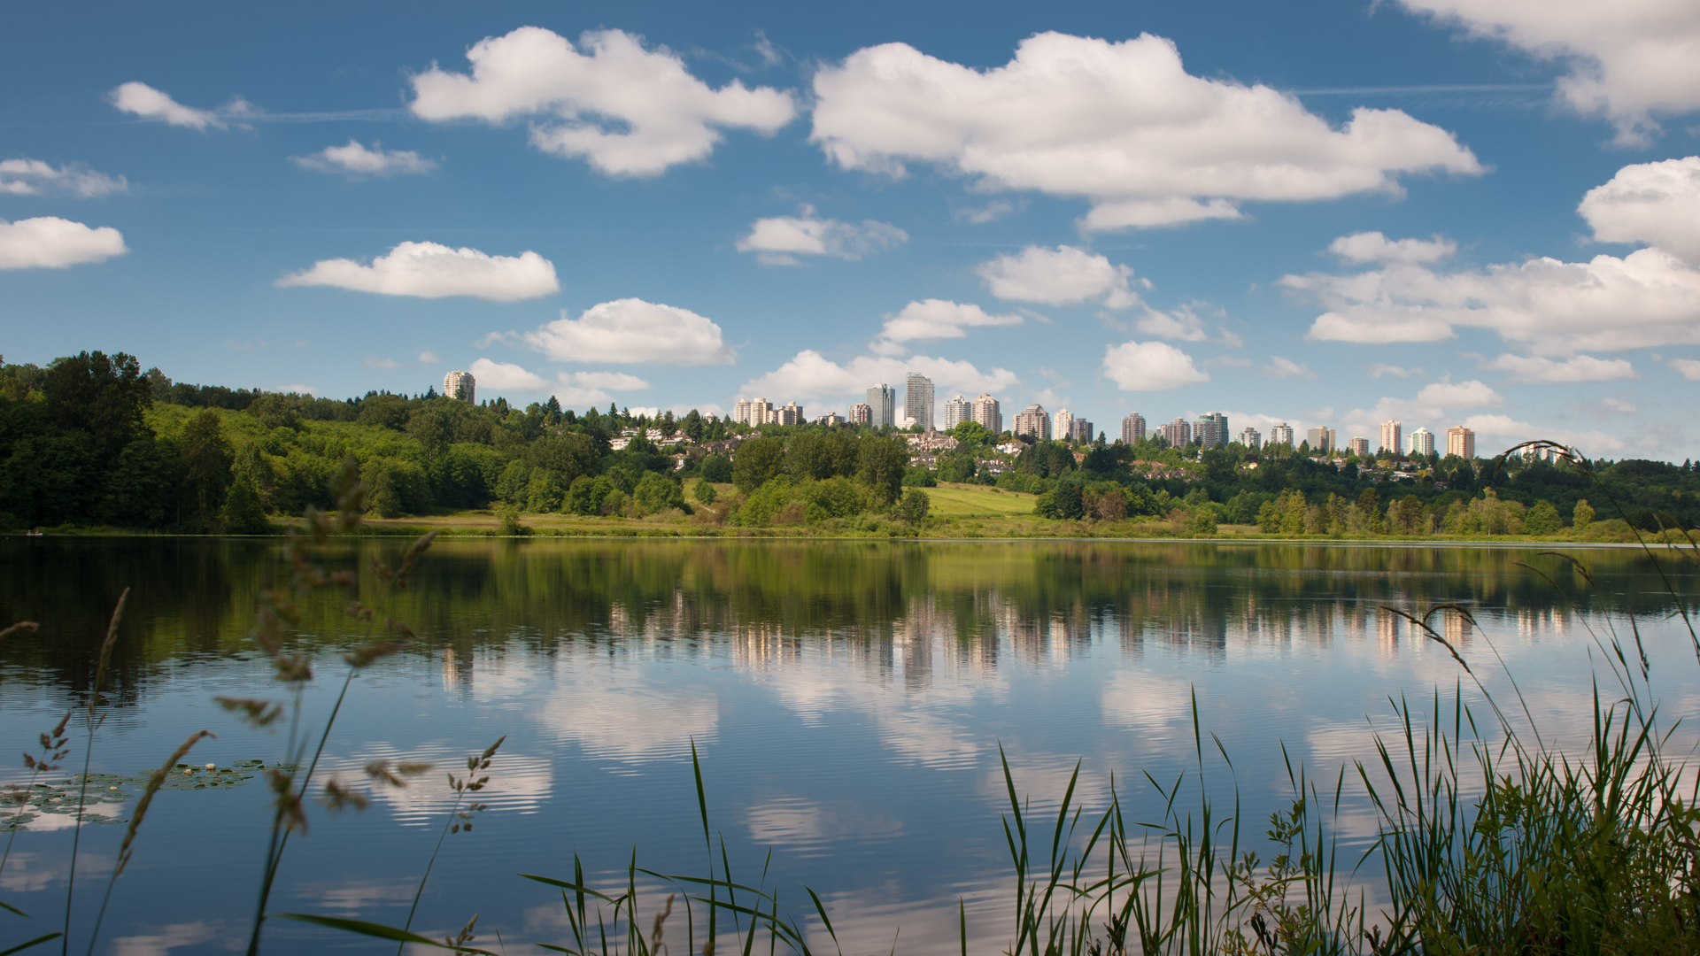
Notes:
Pledge and BBOT logos. Maybe we can make this whole slide a picture? Maybe the grassy walkway one?

Slide 40
Burnaby Board of Trade
201-4555 Kingsway
Burnaby, BC V5H 4T8
604-412-0100
bbot.ca
bbotpledge.ca
Notes:
Pledge and BBOT logos. Maybe we can make this whole slide a picture? Maybe the grassy walkway one?

Slide 41

Credits
Deer Lake Park Panorama by Kenny Louie on Flickr, CC BY 2.0
Playground of the Gods on Burnaby Mountain by Kyle Pearce on Flickr, CC BY-SA 2.0
Deer Lake Morning by Kenny Louie on Flickr, CC BY 2.0
Notes:
Pledge and BBOT logos. Maybe we can make this whole slide a picture? Maybe the grassy walkway one?

Slide 42
Presented by
Notes:
Pledge and BBOT logos. Maybe we can make this whole slide a picture? Maybe the grassy walkway one?

